Slide 1
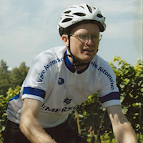
How I Taught My Bike to Fly: Brain Injury Therapy with a Joystick
https://teamtoddtbi.blogspot.com/

Slide 2
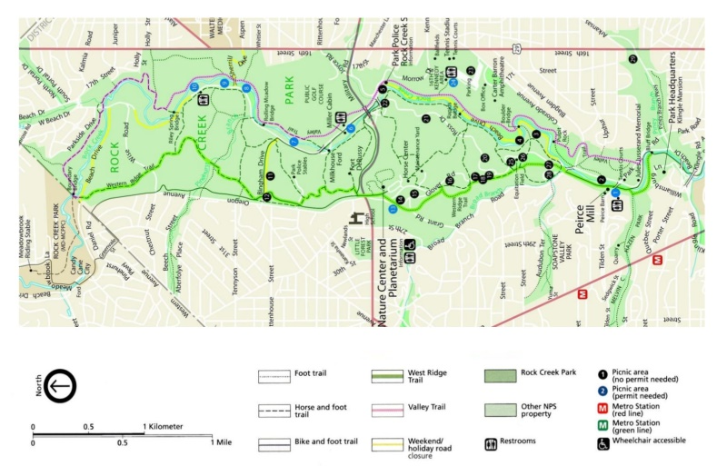
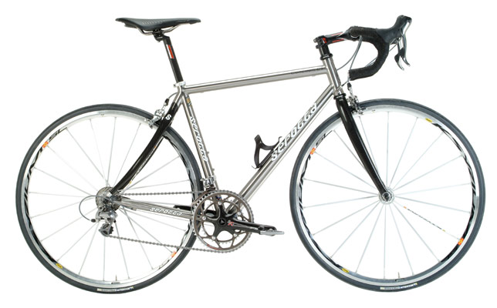
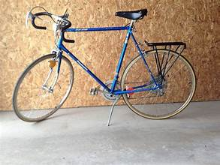
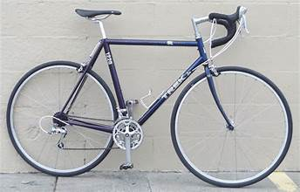
Prelude
Rock Creek Trail
Serotta Concourse CS Ti
$20 Bike in College
Trek 1220

Slide 3
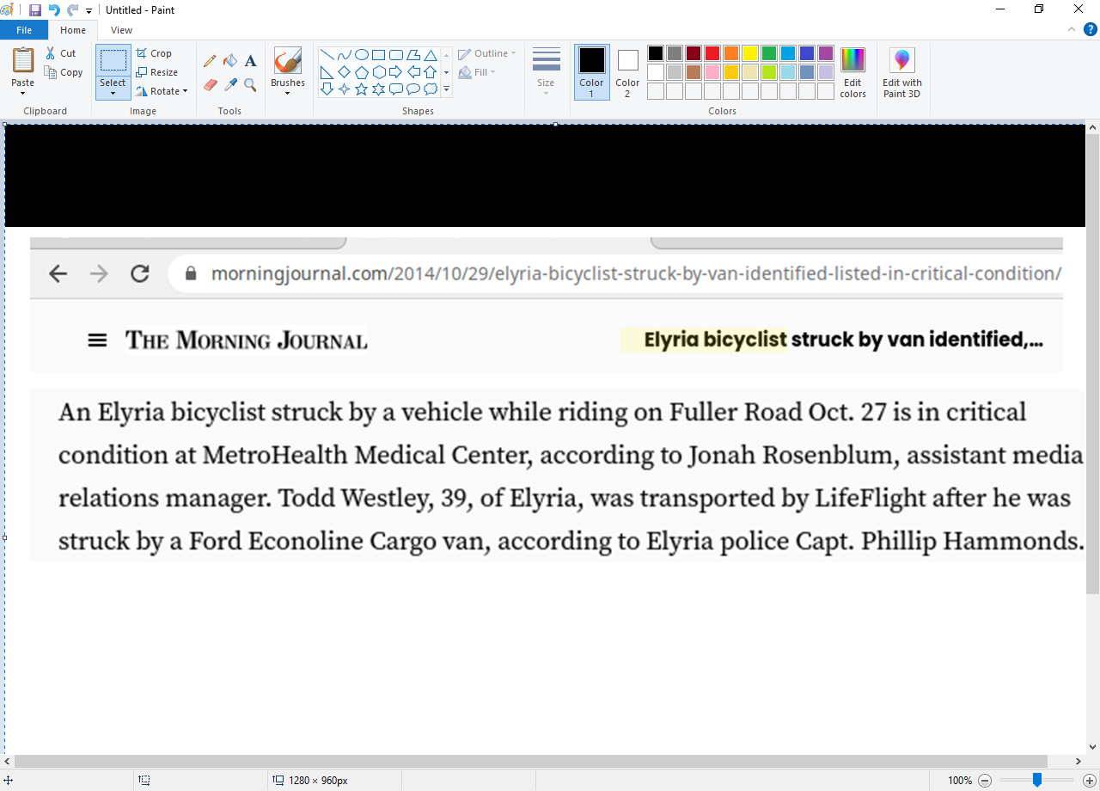
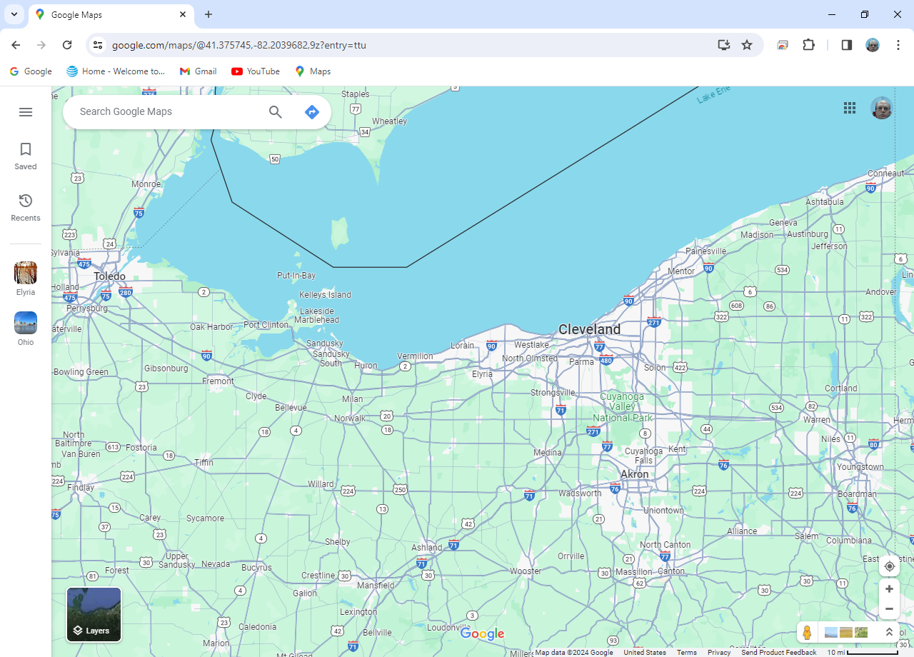
Justification Why Todd is Presenting
Todd resided here
Notes:
This article describes how I got my brain injury.
Note: I lived in Ohio at the time
<number>

Slide 4
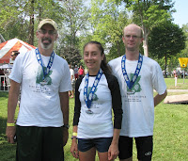
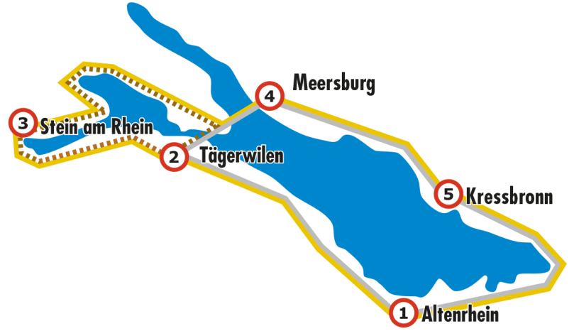
Presentation Background
I have been a cyclist since college:
Cyclist on relay team that won a Triathlon
In Vermillion Ohio
Completed
200 km ride around European Lake Constance
while I worked in Switzerland for 6 months.
Lake Constance
Notes:
Thank you…
Background – I have been riding since I was 20.
<number>

Slide 5
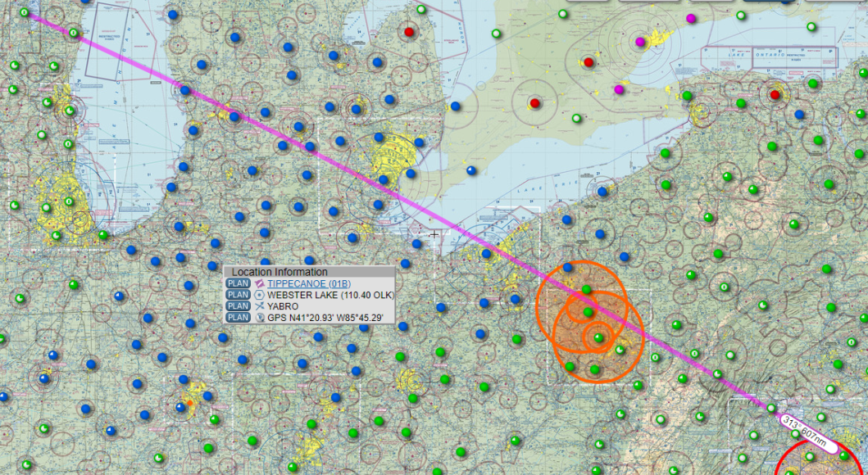

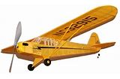
How Todd Got Involved in Aviation
Went to a few airshow s in Oshkosh, WI with Uncle Steve when I was young.
EAA
When I was older, I worked on Steve’s project to build Piper Cub from plans.
Notes:
Went to air show in Oshkosh Wisconsin with Uncle Steve
After college, he started building a Piper Cub from plans
<number>

Slide 6
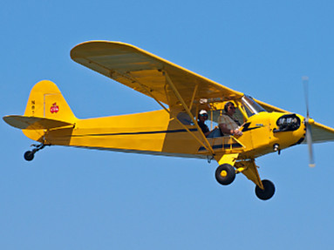
More of Todd’s Aviation Background
Initially, bike trainer to flight stick throttle innovation required elevated privileges.
Notes:
Flying without flight lessons or a pilot’s license is not unheard of. I thought I should be at least by at least familiar with a piper cub aeronautical characteristics.
Who can tell me the names of two people who flew without single a lesson?
I maintained my cycling abilities while living in the NE Ohio by riding a bike trainer.
I combined them and translated rear tire speed into a throttle position.
<number>

Slide 7
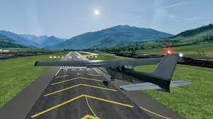
FlightGear
My configuration worked for me; but, no one knew about the bike trainer hardware / software I used.
After moving back home, I sought to revive this technology and improve upon it so it could be shared with others.
Above: link to FlightGear
Notes:
I shared my habit with few; When I started to live at my parents home …. I wanted to virtually fly again
I included a link to FlightGear on this slide.
<number>

Slide 8

Throttle Axis
Details: Playing a flight simulator with a joystick with a throttle axis is better than
just using a keyboard and mouse.
Throttle axis
Notes:
I enjoyed playing FlightGear so I purchased a flight stick…
That was not enough to me

Slide 9

Todd’s Bike on a Trainer
Details: I knew a bike on a trainer could be used to control the throttle axis.
Bottom bracket
Bike on trainer; sweat guards in place.
Sweat guards prevent corrosion.
I have already replaced the bottom bracket twice!
Notes:
I wanted to use my bike on the trainer again
Here is my bike on a trainer…
I try not to sweat; body sweat corrodes bottom bracket
Sweat guards prevent damage to your bike
I now take improved protective measures: I use fans to blow the sweat away now.
This is the bike in our basement

Slide 10

Speed Sensor Close-up
Details: How could the speed sensor on the rear wheel be used?
Speed sensor
A speed sensor is required! Above is a link to Amazon.com
Notes:
Initially, the sensor only work with a cell phone app. But, again, I was not satisfied. I knew I could do better. I captured its data with a R Pi.
Then on my linux desktop, and finally the Arduinos
I still wanted to share my quirk with Windows users.

Slide 11
What is an Arduino?
From “opensource.com”:
In a nutshell, an Arduino is an open hardware development board that can be used by tinkerers, hobbyists, and makers to design and build devices that interact with the real world.
Notes:
Here is a description of an Arduino

Slide 12

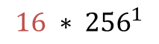
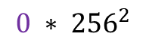

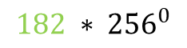
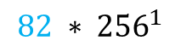
Math Used by Arduino Leonardo
Details: When the wheel is spinning, the speed sensor transmits, with blue
tooth low energy, information on the total number of spins and angular
speed of the last spin.
Here is an 8 byte transmission (that occurs every second unless the
speed sensor stops spinning for 2 minutes) [going forward, the
transmitted information will be referred to as an array of 8 unsigned bytes called rawValue]:
1 ,5 ,16 ,0 ,0 ,182 ,82 ,0
The total number of rotations is the sum of
The “last event”
8
Reverse IBM form
$5∗{256}^{0}$
Total rotations
$16∗{256}^{1}$
5+4096+0+0=4101
$0∗{256}^{2}$
$0∗{256}^{3}$
Last Event Time
$182∗{256}^{0}$
182+20992=21174
$82∗{256}^{1}$
Notes:
The Wahoo sensoir transmits 8 bytes every second
I learned this while using a linux based Raspberry PI – I use linux OS; not Windows. But my scheme still works for Windows users.

Slide 13

Programming Space Full
Details: Merely, capturing this stream of bytes filled the programming space of an Uno
WiFi Rev2 Arduino.
A second Arduino is required.
Note: The BLE signal from the speed sensor must be read by a sensor no
more than arms length away.
Important to remove power from this Arduino after each ride,
Otherwise it will continue to deplete the battery of the speed sensor
Notes:
Program storage space of Uno WIFI rev 2 filled
2nd Arduino Leonardo acts as the joystick…
Source code available on github.

Slide 14


Arduino In Use
Details: These 8 bytes of information are transmitted via the wire interface
(using the ground, SCL [serial clock], and SDA [serial data] pins) to an
Arduino Leonardo that can act as joystick.
Uno Wifi Rev2
Leonardo
Notes:
Leonardo and Uno Wifi Rev2 shown. Note the wires to channel information from the uno to the leonardo
I am not gifted at physical skills…this is the way I use it.

Slide 15
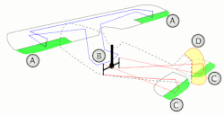
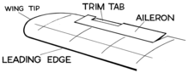
Aircraft Control Surfaces
Besides the throttle, there are other controls:
keyboard
surface trim tab
Bank aileron A 4,6 :,”
Pitch elevator C 2,8 1,7
Yaw rudder D - -
Auto-coordination between rudder and aileron in use
Keystrokes will be shown in upper center of this
screen during flight
Source: https://en.wikipedia.org/wiki/Flight_control_surfaces
Notes:
Here is an illustrations of the controls I use while flying.
<number>

Slide 16
Todd’s Email Address
Todd’s email: toddwestley@gmail.com
Some details in the Arduino code that I concede are mathy:
Constants
SpeedGradient, SpeedDelta, MaxSpreed
Using spreadsheet to determine speedGradient, speedDelta, maxSpeed
Notes:
Trainer resistance abates as it is used. How was this accounted for?
This is intended for those that want to understand details of how I transformed my bike.
<number>

Slide 17

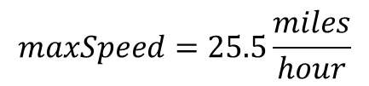
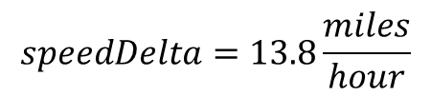
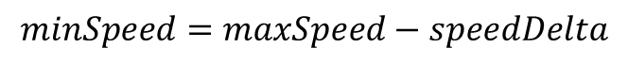
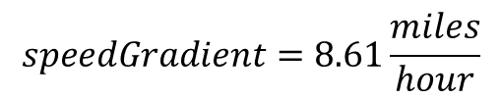

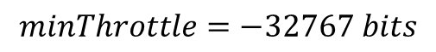
Constants
$wheelCirCM=2096mm$
based on the type of tire. This for a 700CC X 23mm road tire
$maxSpeed=25.5\frac{miles}{hour}$
This the highest speed you could theoretically obtain after operating the trainer for a long time
$speedDelta=13.8\frac{miles}{hour}$
$minSpeed=maxSpeed−speedDelta$
$speedGradient=8.61\frac{miles}{hour}$
You pick this constant…help on this follows on the next slide
$maxThrottle=32767bits$
This is the highest resolution possible
$minThrottle=−32767bits$
Notes:
Constants
Wheel circumference can be found internet.
Note: I try to state units explicitly – this is a trick I used to pass the PE examination to eliminate incorrect answers on the multiple choice portion of the test.
I embedded a spreadsheet to use the serial output from you riding your bike on a trainer, to calculate your speedGradient.
<number>

Slide 18
SpeedGradient, SpeedDelta, MaxSpreed
How are SpeedGradient, SpeedDelta, and MaxSpeed defined?
I found something that worked for me…. Below is a link to a spreadsheet
You can adjust the parameters in cells L2:L3 see how they impact an actual ride (blue dots) from their use (red line). You can copy the contents to a new sheet and replace data in column A from one of your actual rides.
Notes:
I made an Excel worksheet so you can determine your own Speed Gradient, SpeedDelta, and MaxSpeed.

Slide 19
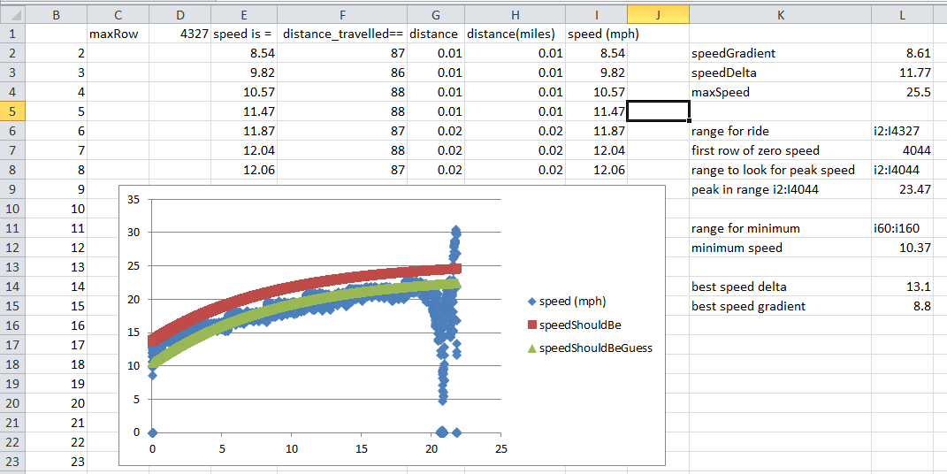
Using spreadsheet
Copy existing sheet into a new sheet
Delete existing serial output
Paste the serial output of your ride into the sheet!
The blue dots are your actual ride
Adjust the parameter in cell L15 until the green dots match the blue dots
Adjust parameters in cells L2:L4 until the red dots are just above blue dots

Slide 20
Questions
I put a lot of thought into how this works.
This diversion brought back the enjoyment of cycling to me. It brought variations from winds, temperatures, and altitude into the basement.
I also enjoy programming and relearning math
It’s not about physical fitness although that is a side effect. The activity, I believe, also led to a low resting heart [bradycardia] rate (<52 bpm).
Questions?
Notes:
When you watch me fly from KGAI to KBWI, I do not translate linearly from a Maximum speed to throttle position: I use more math and account for the trainer’s decrease in resistance from use.
<number>

Slide 21
Justification Why Todd is Presenting
Presentation Background
Presentation Publicly Available
How Todd Got Involved in Aviation
More of Todd’s Aviation Background
FlightGear
Throttle Axis
Todd’s Bike on a Trainer
Speed Sensor Close-up
Math Used by Arduino Leonardo
Programming Space Full
What is an Arduino?
Arduino In Use
Aircraft Control Surfaces
Todd’s Email Address
Constants
SpeedGradient, SpeedDelta, MaxSpreed
Using spreadsheet
Questions?
And/or
Watch Todd fly virtually from KGAI to KBWI [About 16 minutes]
Notes:
Questions?
<number>

Slide 22
Presentation Mechanics
What I did to present:
Wrote a batch file:
cd E:\CoolTermWin64Bit
start coolTerm.exe e:\coolTermWin64Bit\connection_settings_zero.stc
cd /d E:\ShowOff
start Showoff.exe
cd /D "C:\Program Files\FlightGear 2020.3\bin"
start /high fgfs.exe --launcher
Used CoolTerm to display Arduino Leonardo serial output
Used ShowOff to show user inputs in upper left of screen
https://www.dcmembers.com/skrommel/download/showoff/
Notes:
Show displays key strokes in upper left
NumPad 7 and Numpad 1 are elevator trim
Numpad 9 and Numpaf 3 are throttle
CoolTerm record text output from Arduino
Text output corresponds to throttle position
Distance gives me a clue if it is too early to shift
I like to record the text output – I am nerdy!
<number>

Slide 23
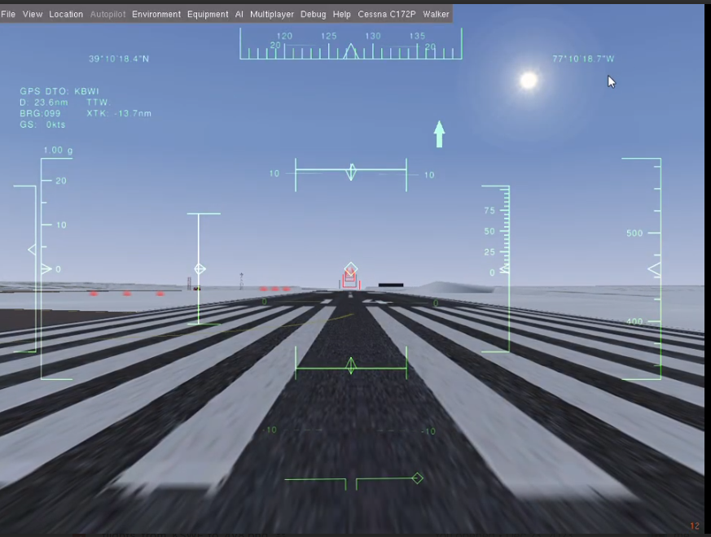
Pre-flight Briefing
GPS destination
Throttle
Air speed (knots)
Aileron (and trim)
Elevator (and trim)
Glide slope
Heading
Altitude above ground
Altitude above sea level
Rudder (auto-
coordination
in use)
Pre-flight briefing
video
Notes:
Here is the Heads Up Display I look at…
GPS, throttle, air speed, aileron (and trim), elevator (and trim), rudder, heading, altitude above ground, altitude above sea level
I takes about two minutes for the software to start running
The flight from Gaithersburg to BWI takes about 16 minutes.
I like to know the aircraft can still get airborne after lands
Center control surfaces and then take off
<number>

Slide 24
Presentation Publicly Available
This presentation is publically available on github:
https://github.com/toddwestley/Arduinos-to-turn-equipped-bike-into-Joystick-with-throtle-axis so you can download these slides.
Search on google for “toddwestley site:github.com”
Notes:
Link to slides; I mispelled throttle; google search for ‘toddwestley site:github.com”
This presentation is about two boring activities: riding a bike trainer and playing a flight simulator.
Combining them rendered an enjoyable activity -- In spite of disability, I still can enjoy cycling.
Lots of hyperlinks in this presentation.

Slide 25
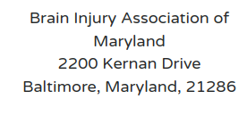
I am in debt to the Holy Spirit for gently encouraging me to move forward on this project.
If you are moved, please make a donation to:

Slide 26
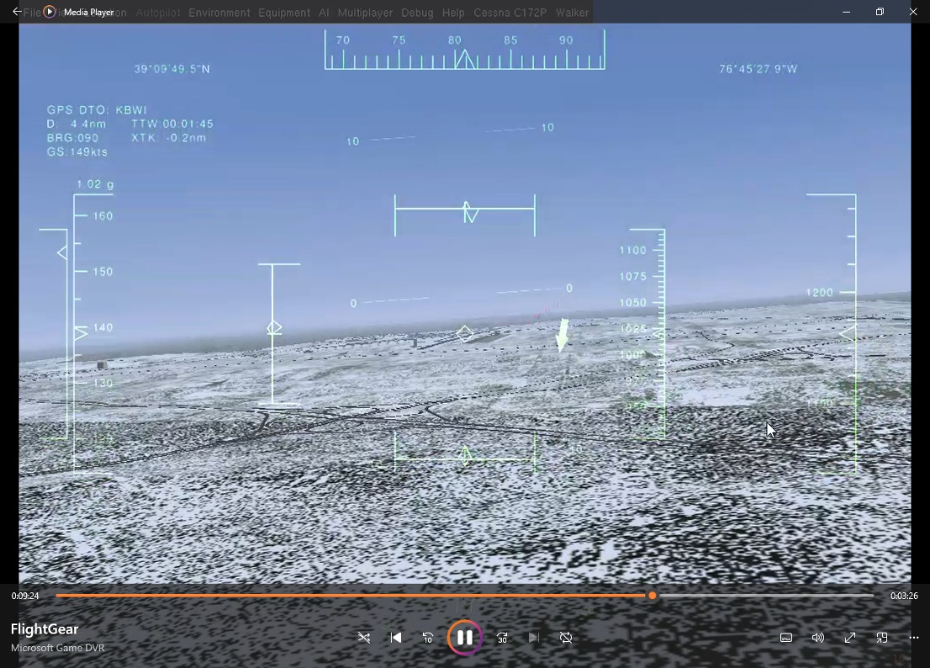
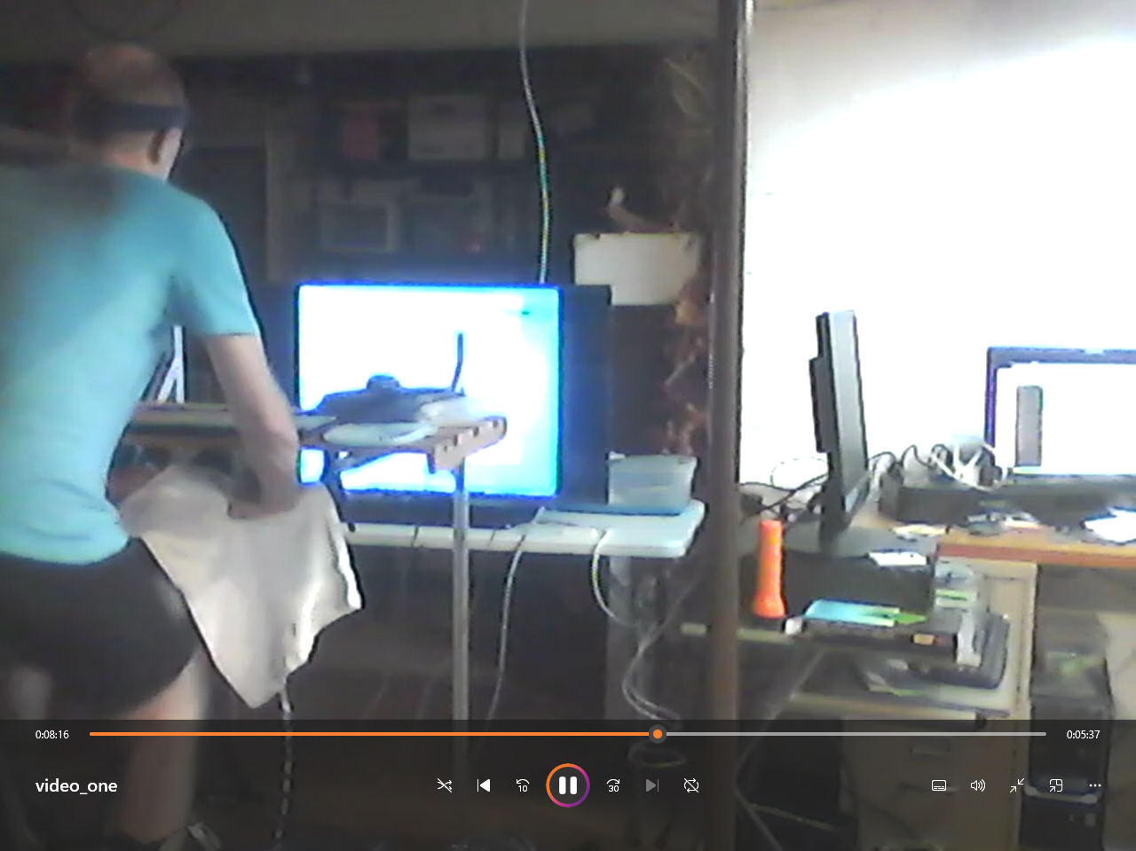
Video of a flight
Video of Todd on a Trainer
back

